Slide 1
Operon system

Slide 2
Contents
Introduction
Operon component
Lac operon

Slide 3
Introduction
Operon is an operating unit which can be defined as the cluster of genes located together on the chromosomes and transcribed together .
It is group of closely linked structural genes and associated control gene which regulate the metabolic activity.
The classical operon model was formulated by Jacob and Monod in 1961.

Slide 4
Operon component
Promoter - Region on DNA where RNA Polymerase binds to start transcription. Acts as the on/off switch for genes.
Operator - Region on DNA that controls access of RNA Polymerase to genes. Can activate or repress transcription.
Structural genes - Genes to be transcribed by RNA Polymerase.

Slide 5
Lac-operon
The Lactose operon designated as Lac-operon.
The Lac-operon codes for enzymes invovled in the catabolism of lactose.
Lactose is the disaccharide which is made up of glucose and galactose.
It is the inducible operon since the presence of lactose induce the operon to switch on.

Slide 6
Structure of Lac-Operon
Promoter
Operator
Regulatory gene: Regulatory gene is the i gene that code for the repressor protein.
Structural gene: Three structural gene Lac z, Lac y, Lac a involved in the synthesis of enzymes for the lactose catabolism. The 3 genes as transcribed in a polycistronic mRNA.
Lac z code for Betagalactosidase.
Lac y code for Lac permease.
Lac a code for Transacetylase.

Slide 8
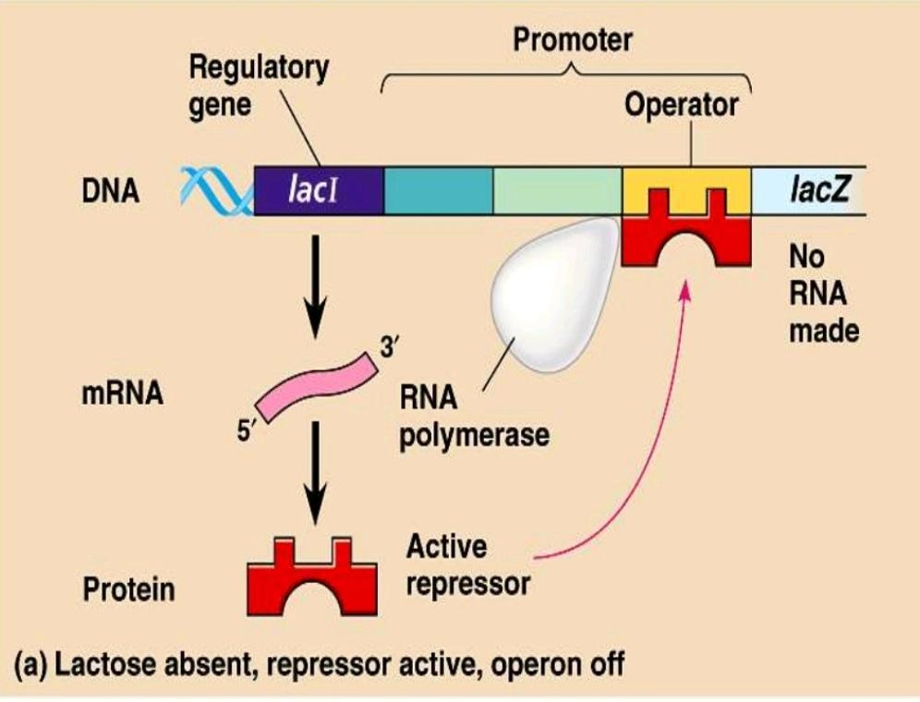
In absence of lactose

Slide 9
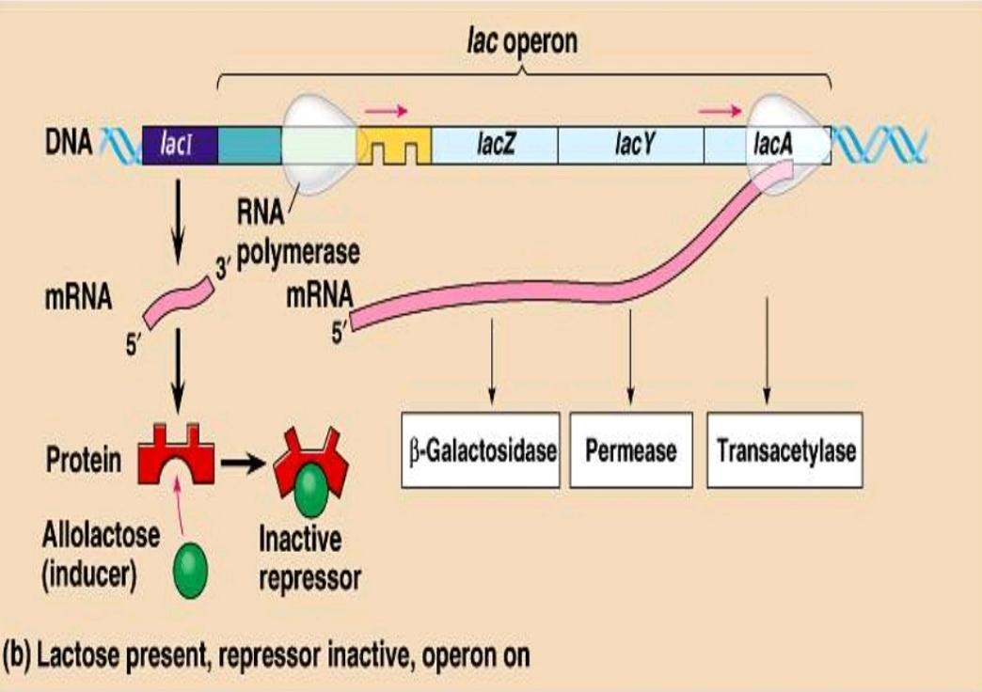
In presence of lactose

Slide 10
THANK YOU

